Slide 1
Agile + Git
8 May 2024, Speaker name

Slide 2
Introduction
Software Development Life Cycle (SDLC) is a systematic process for building software that ensures the quality and correctness of the software built.
Why SDLC is Important:
Structured Framework
Risk Management
Quality Assurance
Improved Project Management
Better planning, monitoring, and control
Cost Efficiency

Slide 3
Simple diagram showing the phases of SDLC
Planning
Identify project scope, resources, timeline, and feasibility.
Requirements
Gather and analyze business and technical requirements.
Design
Create the architecture and design for the software.
Development
Actual coding and building of the software.
Testing
Ensure the software is bug-free and meets requirements
Deployment
Deliver the software to the end-users.
Maintenance
Ongoing support and enhancement.

Slide 4
SDLC Models
Waterfall Model
Linear and sequential
Agile Model
Iterative and incremental
Other Models Spiral, V-Model, etc.

Slide 5
Agile Methodology: A Brief Overview
Agile is Iterative and Incremental
Projects are broken down into smaller, manageable cycles (sprints).
Agile Emphasizes Collaboration and Flexibility
Cross-functional teams work closely together.
Deliverables are produced in increments, allowing for continuous feedback and adaptation.
Visual: A simple diagram showing the iterative sprint cycle.
Regular communication and feedback are essential.
Adaptability to changing requirements is prioritized.
Visual: An image of a team collaborating around a whiteboard or a diagram showcasing the feedback loop.
Agile Delivers Value Quickly
Focus on delivering working software early and often.
Prioritizes customer satisfaction through continuous delivery.
Enables faster time-to-market..

Slide 6
Popular Frameworks
Scrum Framework
Scrum is an Agile framework for managing complex projects
To deliver high-quality, functional software in short cycles, allowing for rapid and flexible responses to change
Kanban Framework
Kanban is an Agile framework focused on visualizing work, limiting work in progress (WIP), and optimizing flow
To improve process efficiency and continuously deliver value without necessarily changing existing workflows.
Iterative and time-boxed (sprints).
Defined roles and ceremonies.
Fixed scope within a sprint.
Continuous flow without fixed iterations.
Focus on visualizing and optimizing the process.
Flexibility in adapting to existing workflows.

Slide 7
Key Principles of Agile
Customer Collaboration
Engaging with customers regularly.
Individuals and Interactions
Emphasizing team communication.
Working Software
Delivering functional software frequently
Responding to Change
Being flexible to changes in requirements.

Slide 8
Key Differences Between Waterfall Model and Agile Model
Waterfall Model
Rigid Requirements
Limited Flexibility
Agile Model
Adaptive Requirements
Minimal Involvement
Fixed Deliverables
Sequential Development
End-of-cycle Testing
High Flexibility
Continuous Involvement
Iterative Feedback
Iterative Development
Continuous Testing

Slide 9
Why Agile?
Early and Predictable Delivery
Regular releases allow for better predictability.
Better Risk Management
Incremental releases help in identifying and mitigating risks early.
Higher Customer Engagement
Frequent interaction with stakeholders ensures alignment with customer needs.
Enhanced Team Morale
Empowered teams with clear goals and regular feedback

Slide 10
Agile Practices
Daily Standups
Short daily meetings to sync up on progress.
Sprint Planning
Planning sessions to define the goals for the next sprint.
Retrospectives
Reflecting on what went well and what can be improved after each sprint.
Continuous Integration
Regularly integrating and testing code.

Slide 11
Working in a Team
Importance of Teamwork
Collaboration
Efficiency
Quality
Adaptability
Morale
Productivity

Slide 12
Key Roles in a Development Team
Developers
Write, debug, and maintain the codebase. Implement features and fix bugs according to the project requirements.
Skills: Proficiency in programming languages, problem-solving, and collaboration
Testers
Design and execute test cases to ensure the software meets quality standards. Identify and report defects for developers to fix.
Skills: Attention to detail, analytical thinking, and knowledge of testing methodologies and tools.
Project Managers
Plan, execute, and close projects. Manage timelines, resources, and communication between stakeholders to ensure project goals are met.
Skills: Leadership, communication, organizational skills, and understanding of project management methodologies (e.g., Agile, Waterfall).
Scrum Masters
Facilitate Scrum practices, remove impediments, and ensure the team follows Agile principles. Support the team in achieving sprint goals.
Skills: Facilitation, conflict resolution, and understanding of Scrum and Agile practices.
Product Owners
Define the product vision and manage the product backlog. Prioritize features and work closely with the team to deliver value to customers.
Skills: Stakeholder management, decision-making, and understanding of market needs and user requirements.
UX/UI Designers
Design the user interface and user experience of the software. Ensure the product is user-friendly and visually appealing.
Skills: Creativity, user research, and proficiency in design tools and principles.

Slide 13
Communication and Collaboration
Communication & Collaboration
Instant messaging for quick communication
Keeping conversations organized
Virtual meetings and video calls to facilitate face-to- face communication
Easy sharing and collaboration on documents, spreadsheets, and presentations
Seamless integration with other Microsoft Office tools
Real-time collaboration on documents and projects
Communication and Collaboration tools example:
1. Microsoft Teams
2. Slack
3. Zoom
4. Email
5. Trello

Slide 14
Pair Programming - Introduction
Pair programming is an Agile software development technique where two programmers work together at a single workstation. One programmer, known as the "driver," writes code while the other, the "navigator," reviews each line of code as it is typed.
Collaborative Coding
Continuous Feedback
Knowledge Sharing
Reduced Defects
Two developers actively collaborate on the same codebase in real-time, fostering teamwork and joint ownership of code.
The navigator provides immediate feedback, suggesting improvements and ensuring adherence to coding standards.
Pair programming promotes learning and skill development as developers exchange ideas, techniques, and best practices.
With both developers focused on code quality, pair programming helps identify and address defects early in the development process.

Slide 15
Roles in Pair Programming
Driver Role
Actively writes code and focuses on implementation tasks.
Navigator Role
Reviews each line of code as it is typed by the driver.
Responsible for typing, debugging, and ensuring code syntax correctness.
Engages in detailed technical implementation.
Focuses on high-level design, strategy, and long-term thinking.
Offers feedback, suggests improvements, and considers the bigger picture.

Slide 16
Benefits of Role-Switching (Pair Programming)
Knowledge Sharing
Improved Code Quality
Enhanced Problem Solving
Exchanges skills, knowledge, and expertise between team members.
Reduces knowledge silos and enhances team collaboration.
Continuous review and feedback reduce errors and improve code readability.
Ensures adherence to coding standards and best practices.
Different perspectives lead to more creative solutions and better problem-solving approaches.
Reduces the likelihood of overlooking critical issues.

Slide 17
Definition of Done (DOD) - Introduction
Criteria for Completion: The DoD outlines specific conditions that a product increment must meet to be considered complete and ready for customers.
Shared Understanding: It represents a common understanding among team members regarding when an increment is release-ready, even for large projects.
Collaborative Agreement: The DoD is agreed upon by the entire project team, including developers, testers, and stakeholders, ensuring smoother sprints and effective hand-offs to other teams.

Slide 18
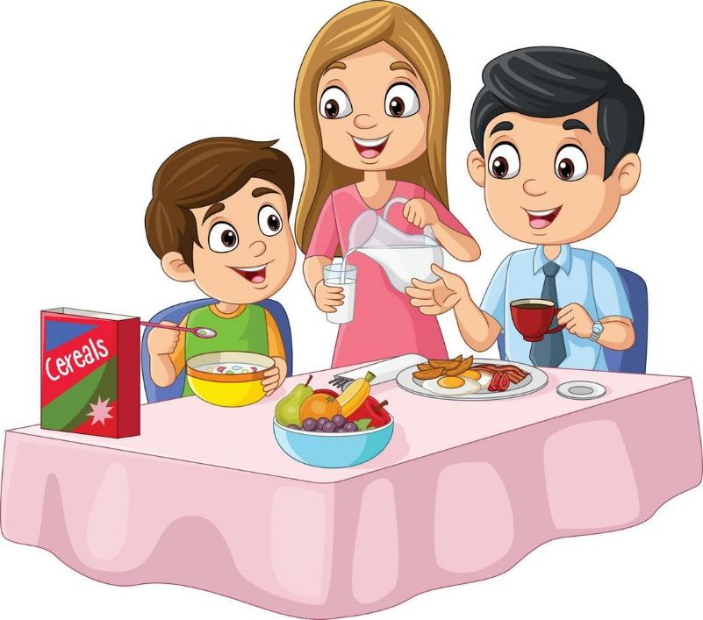
Example of DOD
What will be the acceptance criteria for have breakfast?
Notes:
Definition of Done: Example:
Example Application:
Scenario: John is responsible for making breakfast for his family.
Process:
John gathers all the ingredients needed for pancakes, bacon, and fruit salad.
He cooks the pancakes until golden brown, prepares crispy bacon, and cuts up fresh fruit for the salad.
After cooking, John plates each item neatly on separate plates.
He then cleans up his cooking area, washes the dishes used, and wipes down the counters.
John serves the breakfast at the table and asks his family members how they like it.
Outcome: If all these steps are completed successfully, John can consider the breakfast preparation task "done.”
Key Points:
Clear criteria: Each step in the DoD is specific and measurable, leaving no ambiguity about what needs to be accomplished.
Quality assurance: Asking for feedback ensures that the breakfast meets the expected quality standards.
Team understanding: Just as in agile teams, where the DoD ensures everyone knows when a task is complete, in a breakfast scenario, it ensures John and his family agree on what constitutes a finished breakfast.

Slide 19
Definition of Ready (DOR) - Introduction
Pre-Evaluation Criteria: The DoR allows teams to assess work before starting it. It defines prerequisites for tasks, user stories, or story points.
Key Considerations: Before beginning a project, teams must clarify target customer needs, project goals, task feasibility, technical requirements, time estimates, and the DoD.
Scrum Alignment: In Scrum, the DoR enables immediate action by ensuring readiness for each backlog item.

Slide 20
Criteria for DOR
What will be criteria, starting point of associating all the substances for breakfast?
Notes:
Example Application:
Scenario: John plans to make breakfast for his family.
Process:
John checks the pantry and refrigerator to ensure he has all the ingredients for pancakes, bacon, and fruit salad.
He selects a recipe for each item and reviews the steps needed for preparation.
John ensures that all necessary cooking tools (skillet, spatula, mixing bowls) are clean and ready for use.
He estimates the time needed to prepare and serve breakfast, considering when his family will be ready to eat.
John confirms with his family members if there are any dietary preferences or specific requests for the breakfast.
Outcome: Once all these preparatory steps are completed successfully, John can consider himself ready to start preparing breakfast.
Key Points:
Preparedness: The DoR ensures that John has everything he needs and is mentally prepared to begin cooking breakfast.
Clarity: Having a defined DoR helps avoid interruptions or delays during the preparation process.
Quality assurance: By confirming preferences upfront, John can ensure the breakfast meets his family's expectations.
By establishing a Definition of Ready for tasks like breakfast preparation, individuals can set themselves up for success, ensuring smooth execution and meeting expectations effectively.

Slide 21
Scrum - Introduction
Definition and Key Principles of Scrum:
Scrum is an Agile framework for iterative product development.
It emphasizes collaboration, transparency, and adaptability.
Key principles include time-boxed iterations (sprints), self-organizing teams, and continuous feedback.
Roles in Scrum:
Scrum Master: Facilitates the Scrum process, removes impediments, and ensures adherence to Scrum practices.
Product Owner: Represents stakeholders, prioritizes the backlog, and defines product requirements.
Development Team: Cross-functional group responsible for delivering increments of work.

Slide 22
Agile Visualization - Kanban
Columns and Cards
Work In Progress (WIP) Limits
Continuous Improvement:
Emphasizes gradual improvement of the workflow and process efficiency.
Tasks are represented as cards that move across columns, each column representing a stage in the workflow (e.g., To Do, In Progress, Done).
Flexibility
Adaptable to various types of workflows and can be easily modified as the project evolves.
Helps limit the amount of work in progress to avoid overloading team members.

Slide 23
Gantt Chart
Project Timeline Visualization:
A Gantt chart visually represents project tasks, milestones, and their durations over time.
Each task is represented as a horizontal bar, with its start and end dates.
Dependencies between tasks are shown, allowing teams to manage project flow.
Key Components:
Task Bars: Represent individual tasks or activities.
Milestones: Highlight significant project events or goals.
Time Scale: Displays project duration (weeks, months, etc.).
Benefits of Gantt Charts:
Clarity: Provides a clear overview of project progress and deadlines.
Resource Allocation: Helps allocate resources efficiently.
Communication: Facilitates communication among team members and stakeholders

Slide 24
Gantt Chart Vs Kanban Board
Gantt Chart
Kanban Board
Timeline Visualization: Displays tasks along a timeline, allowing for clear visualization of task durations and deadlines.
Columns and Cards: Tasks are represented as cards that move across columns, each column representing a stage in the workflow (e.g., To Do, In Progress, Done).
Task Dependencies: Shows relationships and dependencies between tasks.
Progress Tracking: Allows tracking the progress of tasks against their planned schedule.
Critical Path: Can highlight the critical path to identify the sequence of crucial tasks that directly impact the project completion date.
Work In Progress (WIP) Limits: Helps limit the amount of work in progress to avoid overloading team members.
Continuous Improvement: Emphasizes gradual improvement of the workflow and process efficiency.
Flexibility: Adaptable to various types of workflows and can be easily modified as the project evolves.

Slide 25
Common Agile Terms
Backlog: A prioritized list of tasks or user stories for a project.
Sprint: A time-boxed period, typically 2-4 weeks, during which a specific set of work is completed.
User Story: A short, simple description of a feature from the perspective of the end user.
Epic: A large user story that can be broken down into smaller stories.
Scrum: A framework for managing and completing complex projects, often used in Agile methodologies.
Burndown Chart: A visual representation of the work left to do versus the time remaining in a sprint.

Slide 26
Case Study
Order to view the portfolio as a user I want to see all the bonds active in the system

Slide 27
DOR Checklist
Clear description of the user story.
Acceptance criteria include a list of active bonds displayed in the user interface.
Dependencies on data sources and APIs are identified.
Story is estimated and agreed upon by the team.
Design mockups or UI sketches are reviewed.

Slide 28
DOD with the Problem Statement
Code for displaying active bonds is implemented and peer-reviewed.
Unit and integration tests for bond display functionality are written and passed.
Documentation (user guides, API docs) is updated to reflect new functionality.
Feature is tested in staging environment and passed UAT.

Slide 29
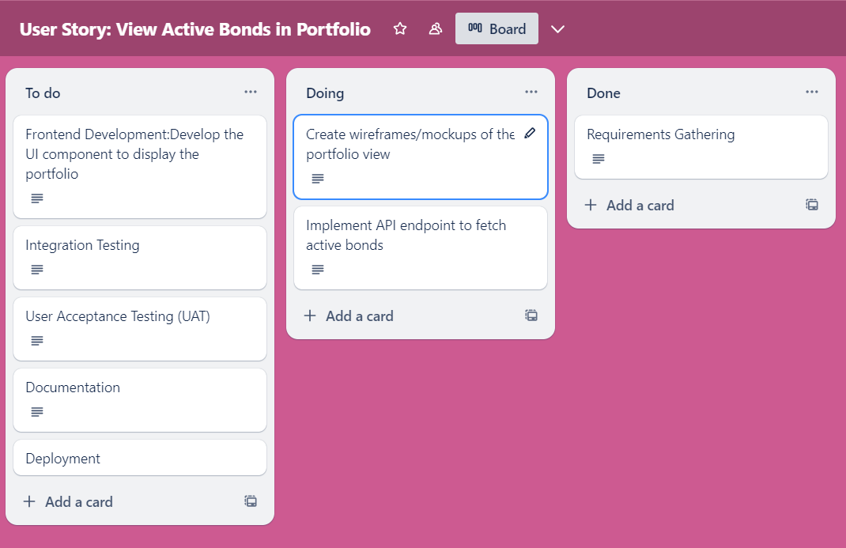
Applying Gantt Chart to the Problem Statement

Slide 30

Applying Pair Programming to the Problem Statement
Developer B (Navigator) reviews code, suggests improvements, and ensures adherence to coding standards.
Developer A (Driver) writes the code to fetch and display active bonds.
Roles switch periodically to maintain engagement and balance workload.

